Slide 1

236781
Lectures 3-4
Deep learning
Deep Neural Networks Optimisation Tecniques
Dr. Chaim Baskin

Slide 2
Neural network training: The basics and beyond

Slide 3
Outline
Optimization
Mini-batch SGD
Learning rate decay
Adaptive methods
Massaging the numbers
Data augmentation
Data preprocessing
Weight initialization
Batch normalization
Regularization
Test time: ensembles, averaging predictions
Transfer learning, distillation

Slide 4
An overview of optimization techniques
Caspar David Friedrich, Wanderer above a sea of fog, 1817

Slide 5
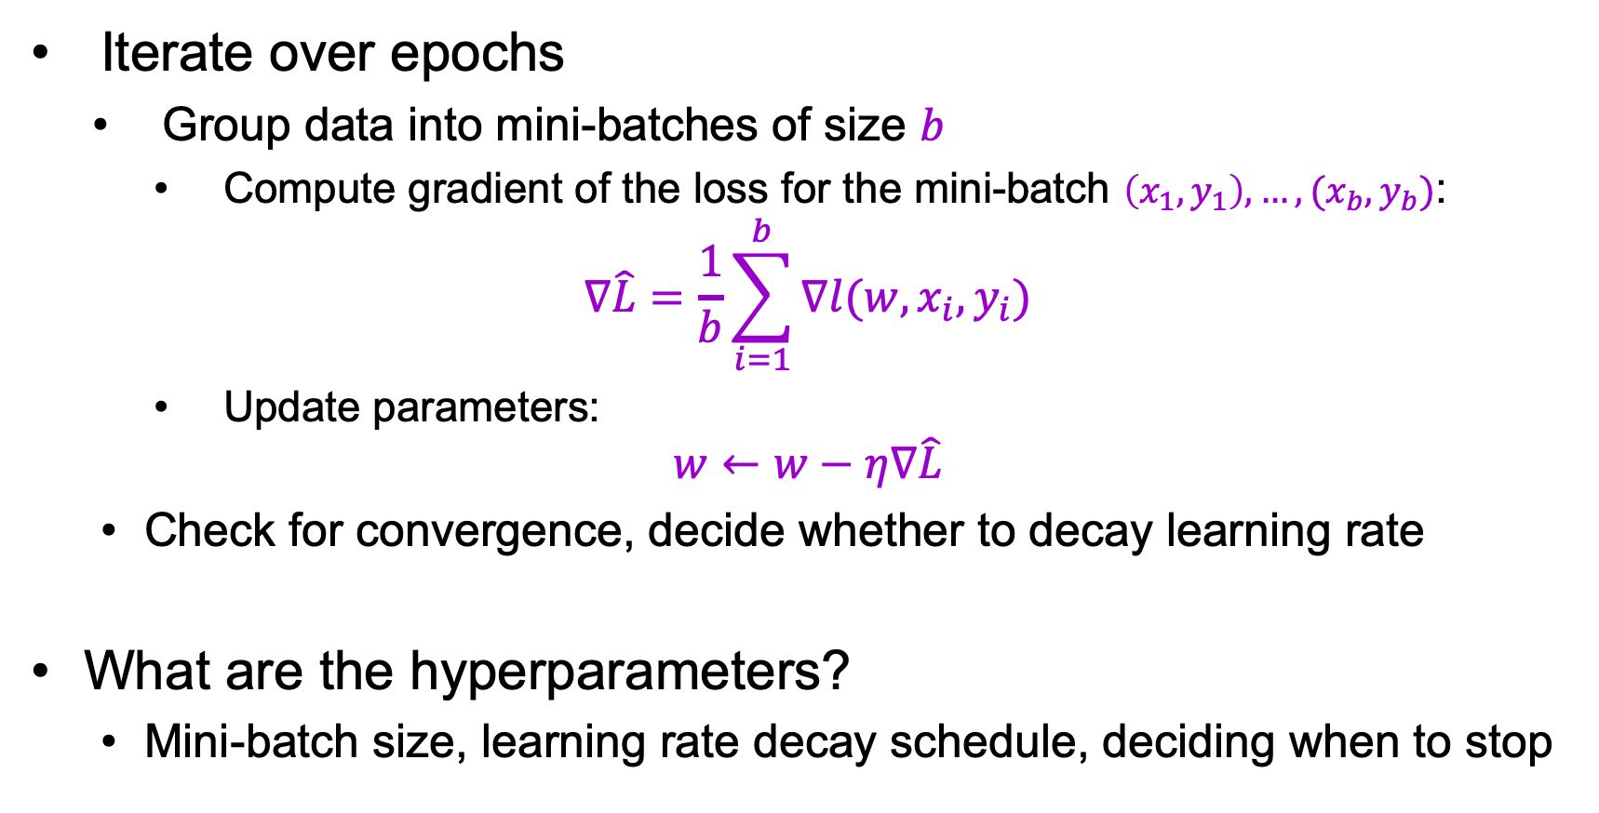
Mini-batch SGD
Iterate over epochs
Group data into mini-batches of size $b$
Compute gradient of the loss for the mini-batch $\left(x_{1},y_{1}\right),…, {(x}_{b},y_{b})$:
$$∇\hat{L}=\frac{1}{b}\sum_{i=1}^{b}{∇l(w,x_{i},y_{i})}$$
Update parameters:
$$w←w−η∇\hat{L}$$
Check for convergence, decide whether to decay learning rate
What are the hyperparameters?
Mini-batch size, learning rate decay schedule, deciding when to stop

Slide 6
Setting the mini-batch size
Smaller mini-batches: less memory overhead, less parallelizable, more gradient noise (which could work as regularization – see, e.g., Keskar et al., 2017)
Larger mini-batches: more expensive and less frequent updates, lower gradient variance, more parallelizable. Can be made to work well with good choices of learning rate and other aspects of optimization (Goyal et al., 2018)

Slide 7
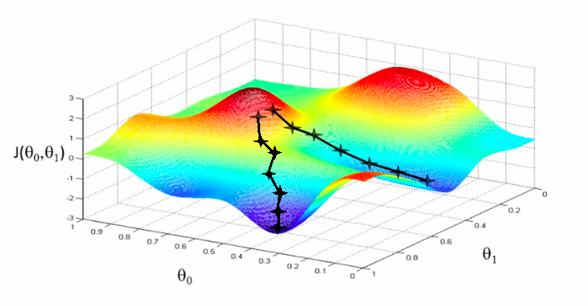
Setting the learning rate

Slide 8
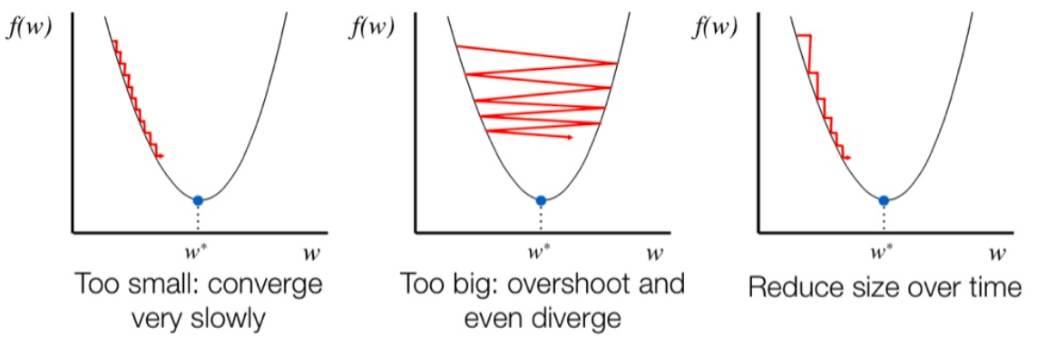
Setting the learning rate
Too high
Too low
Want: good decay schedule
Figure source

Slide 9
Setting the learning rate
Too high
Too low
Want: good decay schedule
Figure source
Source: Stanford CS231n

Slide 10
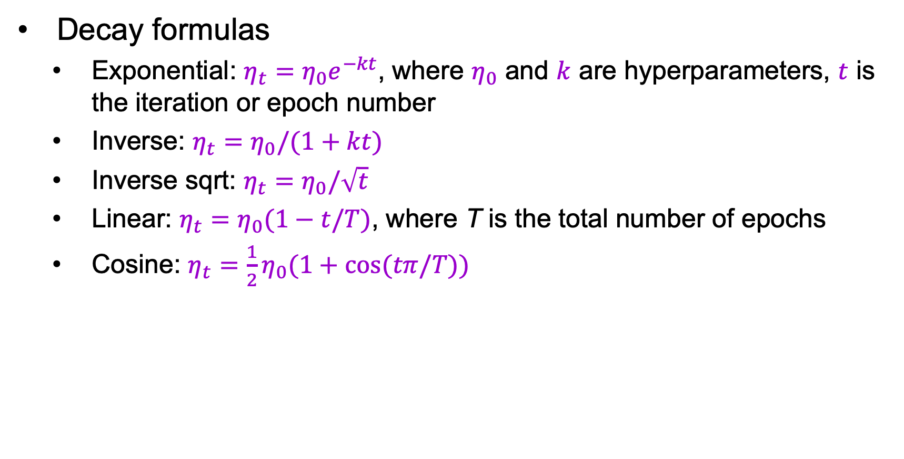
Learning rate decay
Decay formulas
Exponential: $η_{t}=η_{0}e^{−kt}$, where $η_{0}$ and $k$ are hyperparameters, $t$ is the iteration or epoch number
Inverse: $η_{t}=η_{0}/(1+kt)$
Inverse sqrt: $η_{t}=η_{0}/\sqrt{t}$
$\text{Linear}\text{: }η_{t}=η_{0}(1−t/T)$, where T is the total number of epochs
Cosine: $η_{t}={\frac{1}{2}η}_{0}(1+cos⁡(tπ/T))$

Slide 11
Learning rate decay
Decay formulas
Most common in practice:
Step decay: reduce rate by a constant factor every few epochs, e.g., by 0.5 every 5 epochs, 0.1 every 20 epochs
Manual: watch validation error and reduce learning rate whenever it stops improving
“Patience” hyperparameter: number of epochs without improvement before reducing learning rate

Slide 12
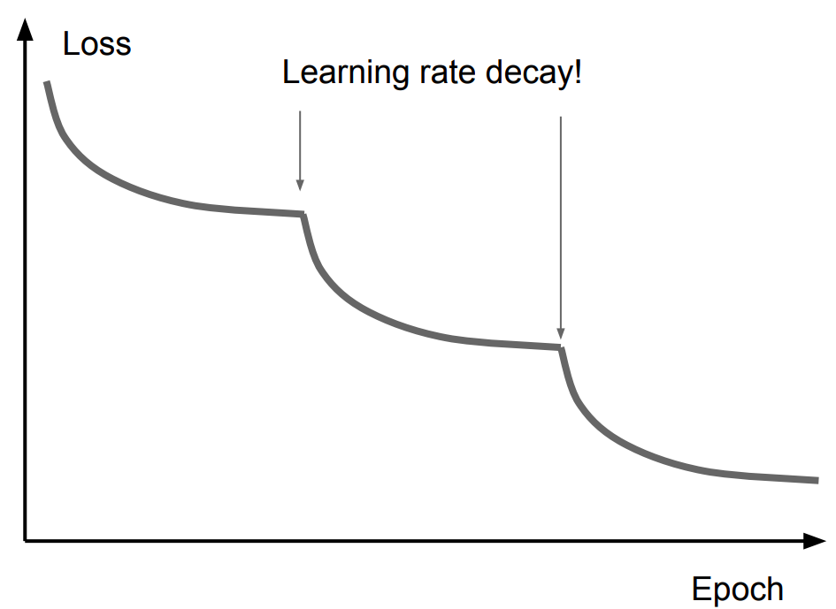
A typical phenomenon
Possible explanation
Image source: Stanford CS231n
Image source
Notes:
From Stanford CS231n: Good intuition to have in mind is that with a high learning rate, the system contains too much kinetic energy and the parameter vector bounces around chaotically, unable to settle down into deeper, but narrower parts of the loss function. Knowing when to decay the learning rate can be tricky: Decay it slowly and you’ll be wasting computation bouncing around chaotically with little improvement for a long time.

Slide 13
Learning rate decay
Decay formulas
Most common in practice:
Step decay: reduce rate by a constant factor every few epochs, e.g., by 0.5 every 5 epochs, 0.1 every 20 epochs
Manual: watch validation error and reduce learning rate whenever it stops improving
“Patience” hyperparameter: number of epochs without improvement before reducing learning rate
Warmup: train with a low learning rate for a first few epochs, or linearly increase learning rate before transitioning to normal decay schedule (Goyal et al., 2018)

Slide 14
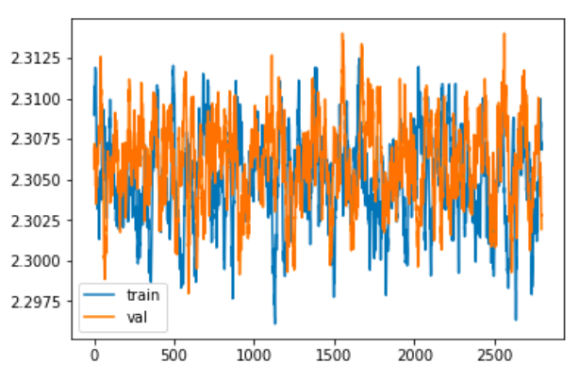
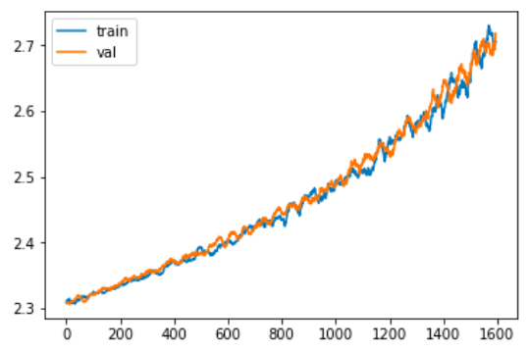
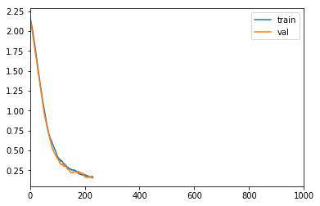
Diagnosing learning curves: Obvious problems
Not training
Bug in update calculation?
Error increasing
Bug in update calculation?
Shuffling off
Shuffling on
Get NaNs in the loss after a number of iterations: Numerical instability
Weird cyclical patterns in loss:
Data not shuffled
Source: Stanford CS231n

Slide 15
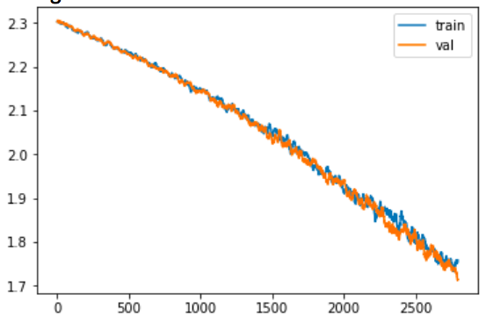
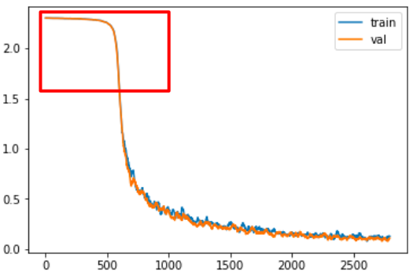
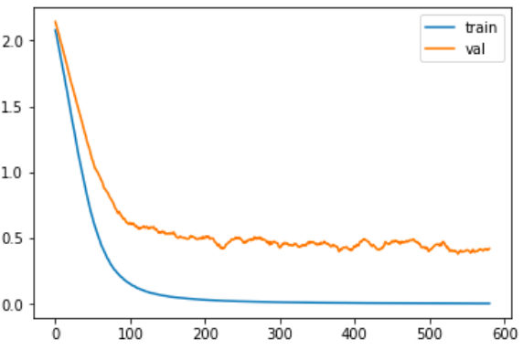
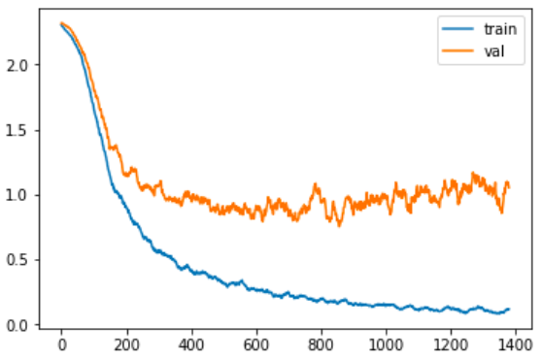
Diagnosing learning curves: Subtler behaviors
Not converged yet
Keep training, possibly increase learning rate
Slow start
Bad initialization?
Possible overfitting
Definite overfitting
Source: Stanford CS231n

Slide 16
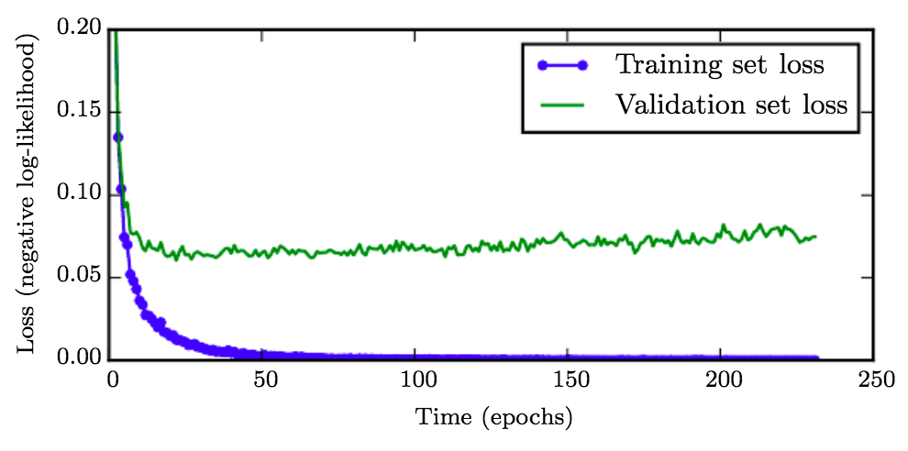
When to stop training?
Monitor validation error to decide when to stop
“Patience” hyperparameter: number of epochs without improvement before stopping
Early stopping can be viewed as a kind of regularization
Figure from Deep Learning Book

Slide 17
Advanced optimizers
SGD with momentum
RSMProp
Adam

Slide 18
Where does SGD run into trouble?
Notes:
What if loss changes quickly in one direction and slowly in another?
What does gradient descent do?
Very slow progress along shallow dimension, jitter along steep direction
Loss function has high condition number: ratio of largest to smallest singular value of the Hessian matrix is large

Slide 19
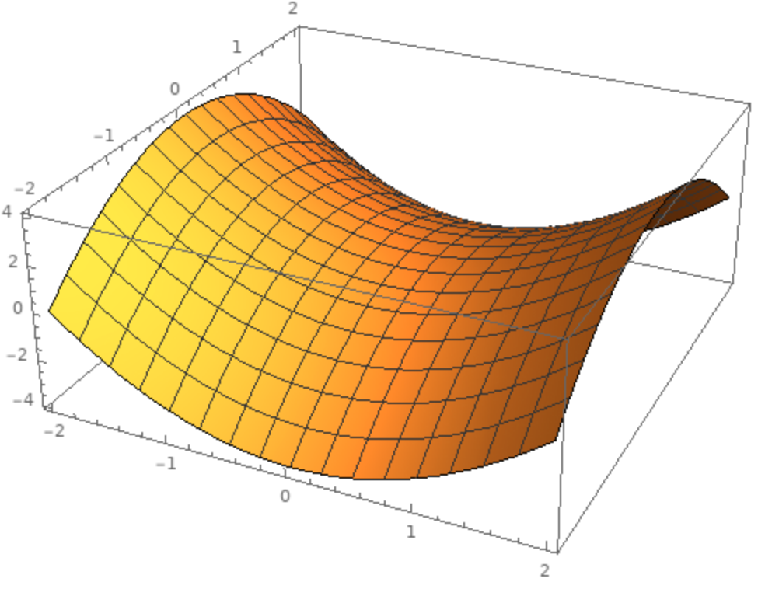
Where does SGD run into trouble?
Local minima
Saddle points
Poor conditioning
Source: J. Johnson
Notes:
What if loss changes quickly in one direction and slowly in another?
What does gradient descent do?
Very slow progress along shallow dimension, jitter along steep direction
Loss function has high condition number: ratio of largest to smallest singular value of the Hessian matrix is large

Slide 20
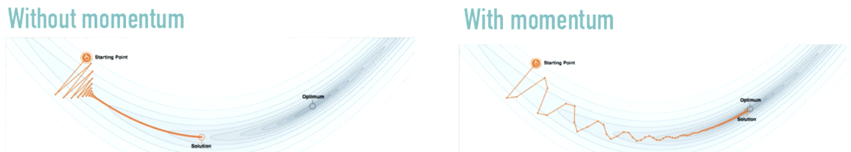
SGD with momentum
Goal: move faster in directions with consistent gradient, avoid oscillating in directions with large but inconsistent gradients
Standard SGD
SGD with momentum
Notes:
SGD Momentum is similar to the concept of momentum in physics. The optimization process resembles a heavy ball rolling down the hill. Momentum keeps the ball moving in the same direction that it is already moving in. Gradient can be considered a force pushing the ball in another direction. Rather than making dramatic changes in the direction of travel (as in the figure on the left), momentum makes modest changes. Momentum dampens the oscillations which are common when we use only SGD.

Slide 21
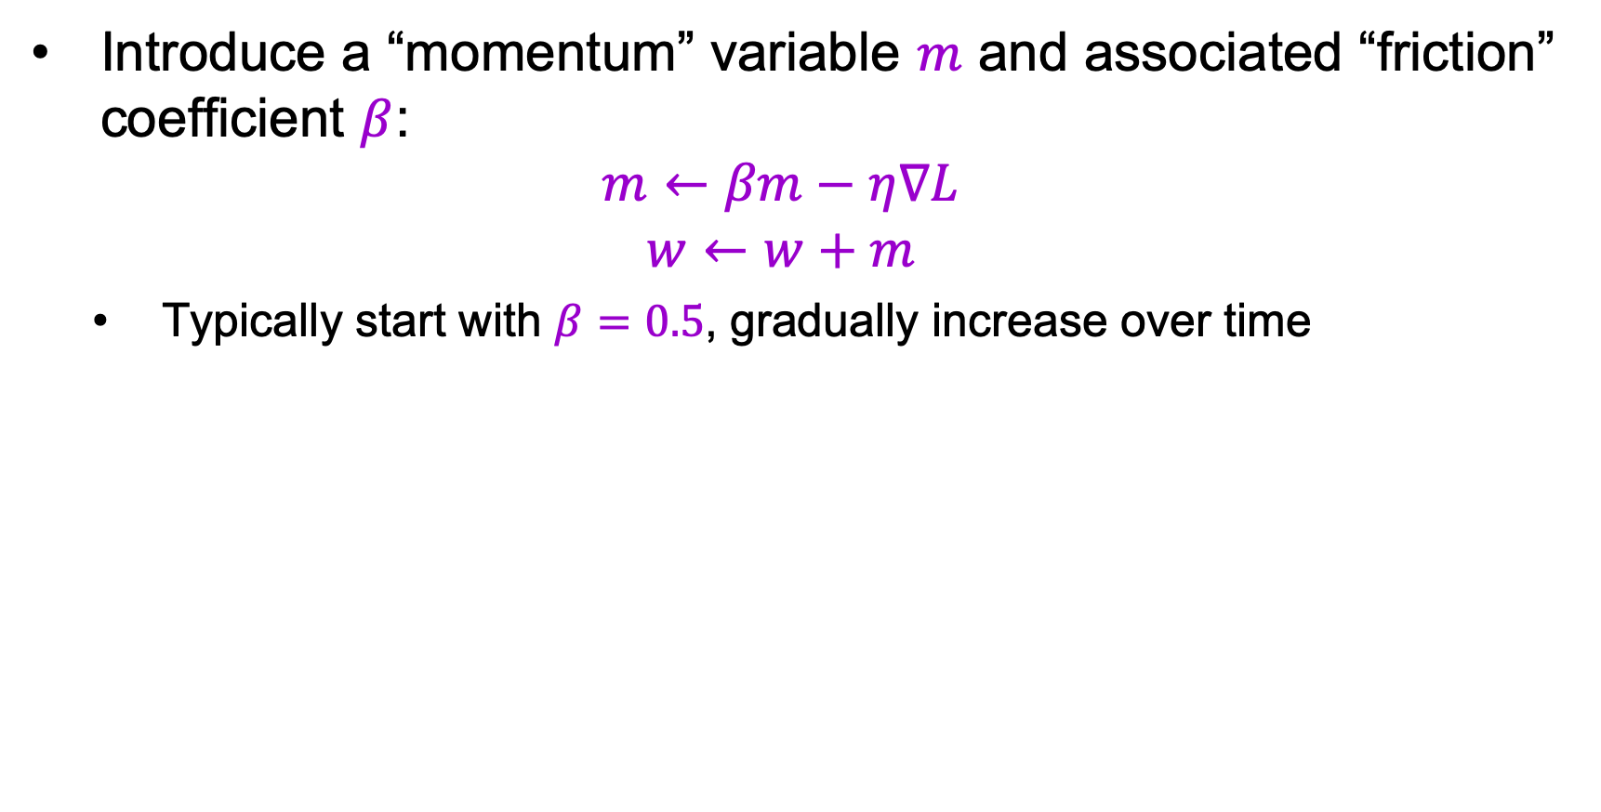
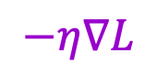
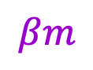

SGD with momentum
Introduce a “momentum” variable $m$ and associated “friction” coefficient $β$:
$$m←βm−η∇L$$
$$w←w+m$$
Typically start with $β=0.5$, gradually increase over time
$$βm$$
actual step
momentum step
$$w$$
$$−η∇L$$
gradient step
Image source

Slide 22
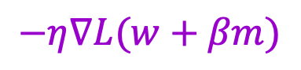
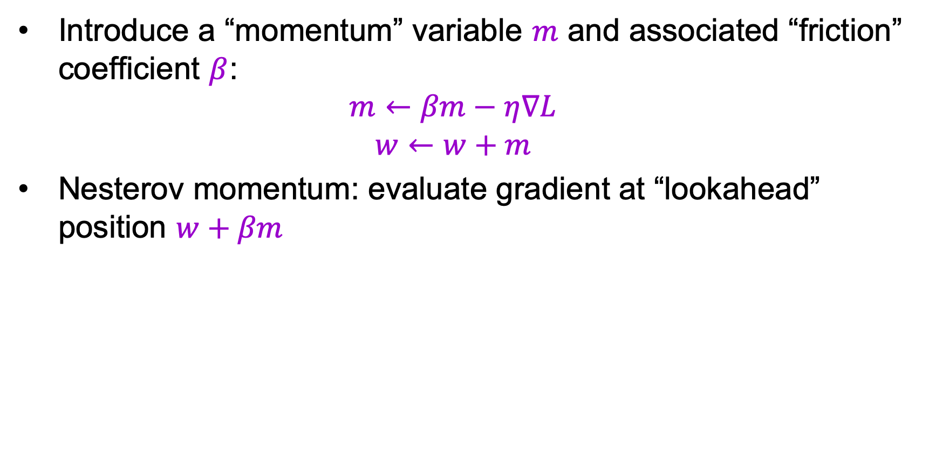
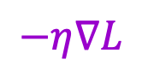

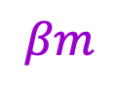

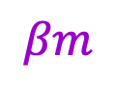
SGD with momentum
Introduce a “momentum” variable $m$ and associated “friction” coefficient $β$:
$$m←βm−η∇L$$
$$w←w+m$$
Nesterov momentum: evaluate gradient at “lookahead” position $w+βm$
$$βm$$
$$βm$$
$$−η∇L(w+βm)$$
$$w$$
$$−η∇L$$
$$w$$
Image source

Slide 23
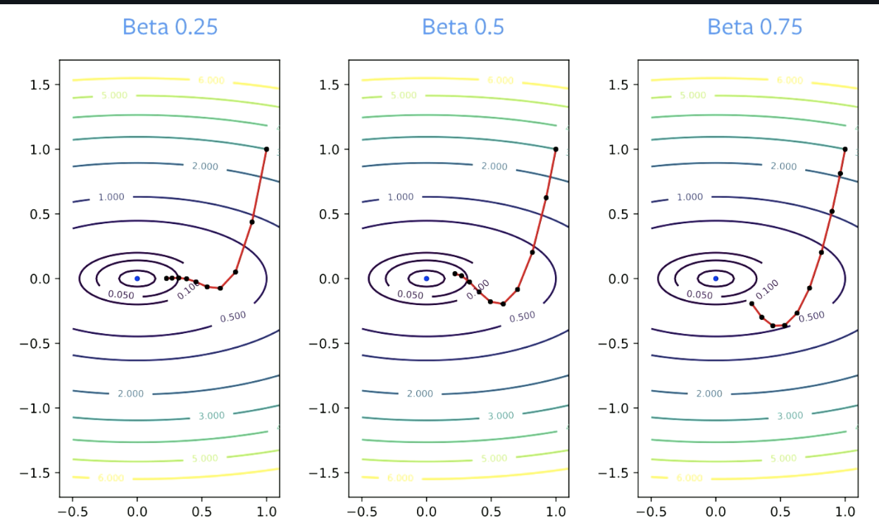
SGD with momentum
Notes:
The \betaβ parameter is called the Dampening Factor. \betaβ has to be greater than zero, because if it is equal to zero, you are just doing gradient descent. It also has to be less than 1, otherwise everything will blow up. Smaller values of \betaβ result in change in direction quicker. For larger values, it takes longer to make turns.

Slide 24
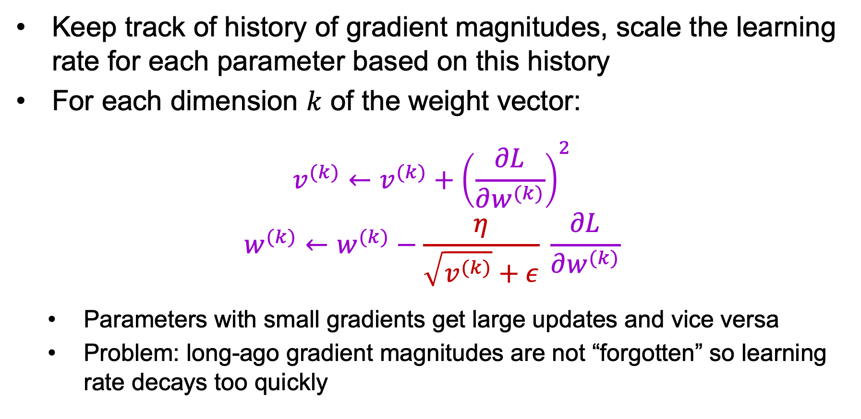
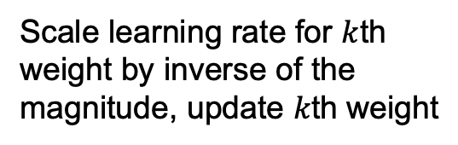
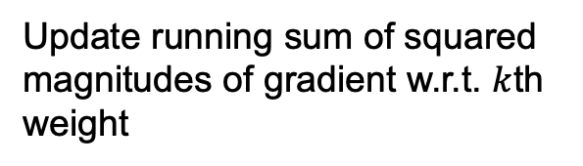
Adagrad: Adaptive per-parameter learning rates
Keep track of history of gradient magnitudes, scale the learning rate for each parameter based on this history
For each dimension $k$ of the weight vector:
$$v^{(k)}←v^{(k)}+{\left(\frac{∂L}{∂w^{(k)}}\right)}^{2}$$
$$w^{(k)}←w^{(k)}−\frac{η}{\sqrt{v^{(k)}}+ε} \frac{∂L}{∂w^{(k)}}$$
Parameters with small gradients get large updates and vice versa
Problem: long-ago gradient magnitudes are not “forgotten” so learning rate decays too quickly
Update running sum of squared magnitudes of gradient w.r.t. $k$th weight
Scale learning rate for $k$th weight by inverse of the magnitude, update $k$th weight
J. Duchi, Adaptive subgradient methods for online learning and stochastic optimization, JMLR 2011

Slide 25
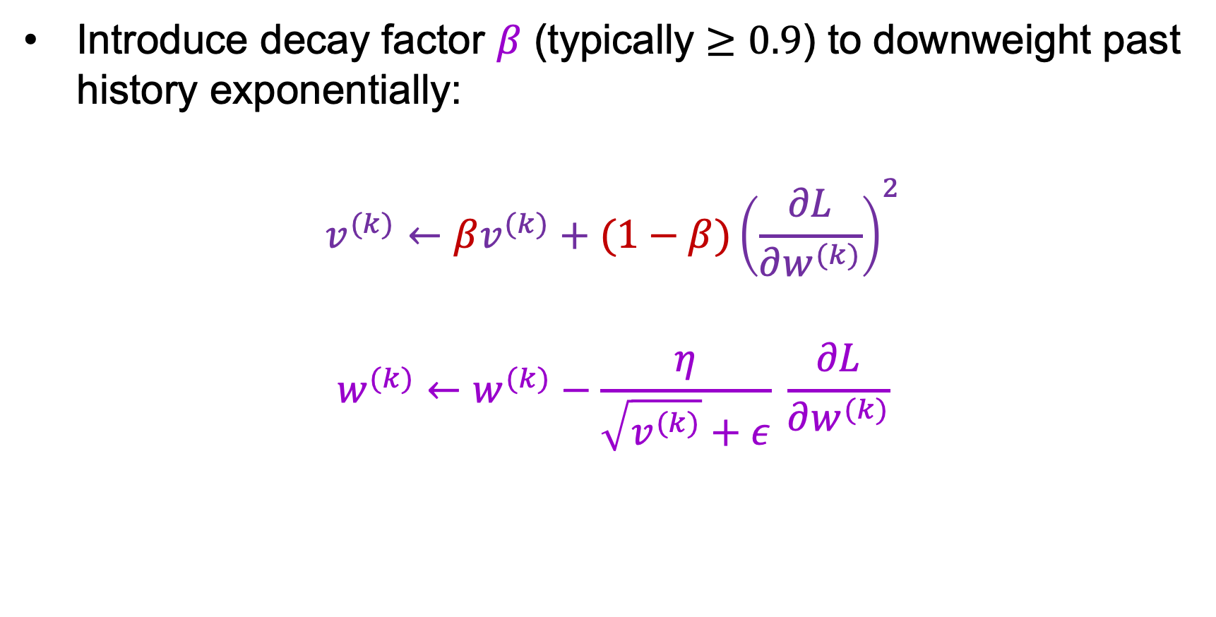
RMSProp
Introduce decay factor $β$ (typically $≥0.9$) to downweight past history exponentially:
$$v^{(k)}←βv^{(k)}+(1−β){\left(\frac{∂L}{∂w^{(k)}}\right)}^{2}$$
$$w^{(k)}←w^{(k)}−\frac{η}{\sqrt{v^{(k)}}+ε} \frac{∂L}{∂w^{(k)}}$$
http://www.cs.toronto.edu/~tijmen/csc321/slides/lecture_slides_lec6.pdf

Slide 26
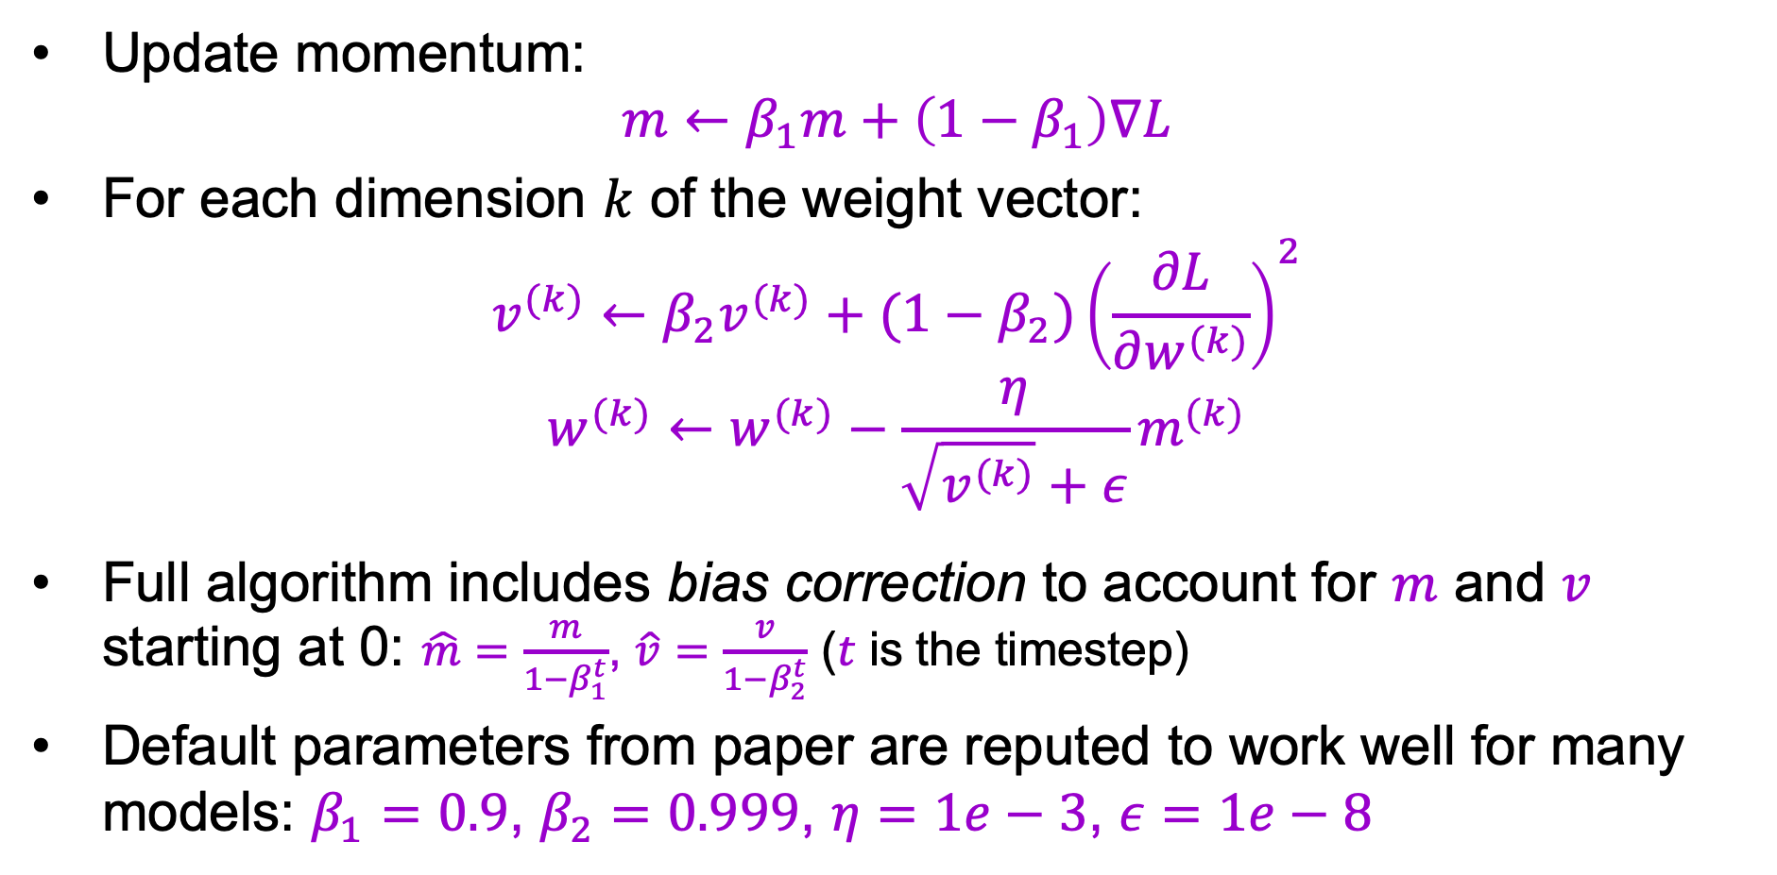
Adam: Combine RMSProp with momentum
Update momentum:
$$m←β_{1}m+\left(1−β_{1}\right)∇L$$
For each dimension $k$ of the weight vector:
$$v^{(k)}←β_{2}v^{(k)}+(1−β_{2}){\left(\frac{∂L}{∂w^{(k)}}\right)}^{2}$$
$$w^{(k)}←w^{(k)}−\frac{η}{\sqrt{v^{(k)}}+ε}m^{(k)}$$
Full algorithm includes bias correction to account for $m$ and $v$ starting at 0: $\hat{m}=\frac{m}{1−β_{1}^{t}}$, $\hat{v}=\frac{v}{1−β_{2}^{t}}$ ($t$ is the timestep)
Default parameters from paper are reputed to work well for many models: $β_{1}=0.9$, $β_{2}=0.999$, $η=1e−3$, $ε=1e−8$
D. Kingma and J. Ba, Adam: A method for stochastic optimization, ICLR 2015
Notes:
ADAM, or Adaptive Moment Estimation, which is RMSprop plus momentum, is a more commonly used method. The momentum update is converted to an exponential moving average and we don’t need to change the learning rate when we deal with \betaβ. Just as in RMSprop, we take an exponential moving average of the squared gradient here.
where m_{t+1}mt+1​ is the momentum’s exponential moving average.
Bias correction that is used to keep the moving average unbiased during early iterations is not shown here.

Slide 27
Which optimizer to use in practice?
Adaptive methods tend to reduce initial training error faster than SGD and are “safer”
Andrej Karpathy: “In the early stages of setting baselines I like to use Adam with a learning rate of 3e-4. In my experience Adam is much more forgiving to hyperparameters, including a bad learning rate. For ConvNets a well-tuned SGD will almost always slightly outperform Adam, but the optimal learning rate region is much more narrow and problem-specific.”
Use Adam early in training, switch to SGD for later epochs?
Notes:
See also:
Descending through a Crowded Valley — Benchmarking Deep Learning Optimizers
https://arxiv.org/pdf/2007.01547.pdf

Slide 28
Which optimizer to use in practice?
Adaptive methods tend to reduce initial training error faster than SGD and are “safer”
Some literature reports problems with adaptive methods, such as failing to converge or generalizing poorly (Wilson et al. 2017, Reddi et al. 2018)
Recent comparative study (Schmidt et al., 2021): “We observe that evaluating multiple optimizers with default parameters works approximately as well as tuning the hyperparameters of a single, fixed optimizer.”

Slide 29
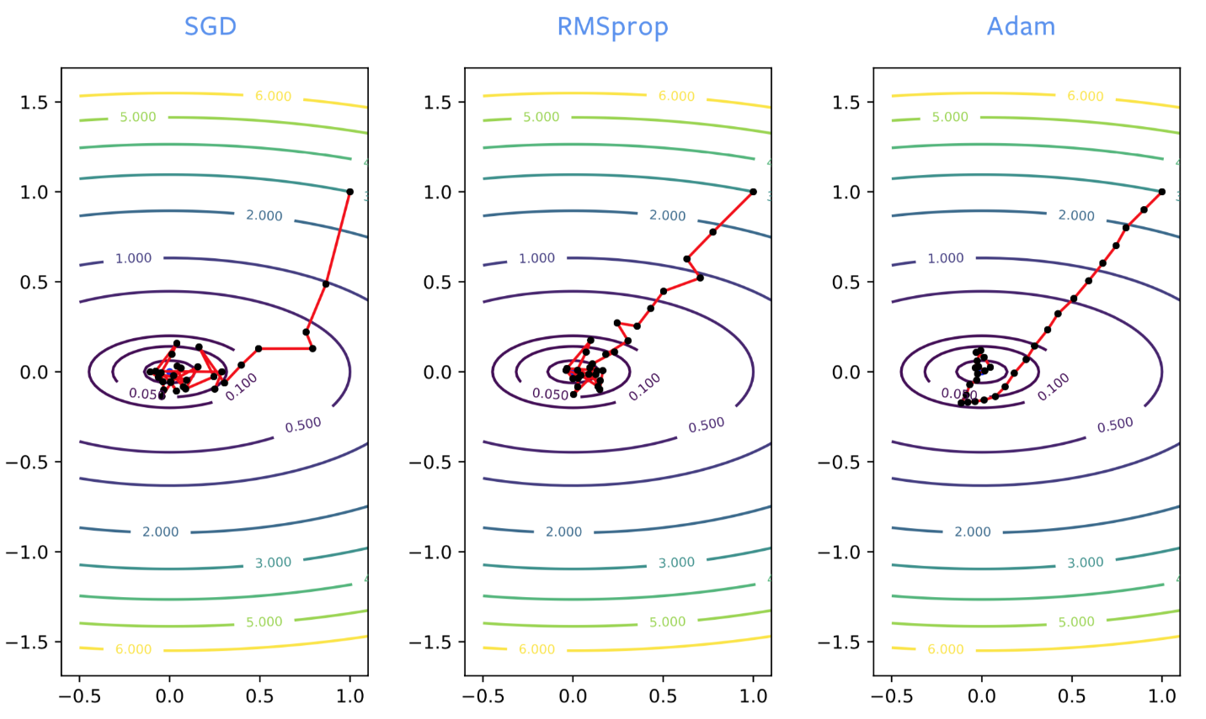
Which optimizer to use in practice?
Notes:
When training neural networks, SGD often goes in the wrong direction at the beginning of the training process, whereas RMSprop hones in on the right direction. However, RMSprop suffers from noise like regular SGD, so it bounces around the optimum significantly once it’s close to a local minimizer. Just like when we add momentum to SGD, we get the same kind of improvement with ADAM. It is a good, not-noisy estimate of the solution, so ADAM is generally recommended over RMSprop.
ADAM is necessary for training some of the networks for using language models. For optimizing neural networks, SGD with momentum or ADAM is generally preferred. However, ADAM’s theory in papers is poorly understood and it also has several disadvantages:
It can be shown on very simple test problems that the method does not converge.
It is known to give generalization errors. If the neural network is trained to give zero loss on the data you trained it on, it will not give zero loss on other data points that it has never seen before. It is quite common, particularly on image problems, that we get worse generalization errors than when SGD is used. Factors could include that it finds the closest local minimum, or less noise in ADAM, or its structure, for instance.
With ADAM we need to maintain 3 buffers, whereas SGD needs 2 buffers. This doesn’t really matter unless we train a model on the order of several gigabytes in size, in which case it might not fit in memory.
2 momentum parameters need to be tuned instead of 1.

Slide 30
Misc. optimization tricks and topics
Adding noise to gradients: SGD with Langevin dynamics helps to jump out of local minima (e.g., Welling and Teh, 2011)
Cyclical learning rates: increase learning rate from time to time to jump out of local minima (Smith 2017)
Second-order methods (e.g., L-BFGS)
Non-gradient or non-backprop methods

Slide 31
Neural network training: Beyond the basics
Optimization
Mini-batch SGD
Learning rate decay
Diagnosing learning curves
Adaptive methods: SGD with momentum, RMSProp, Adam
Massaging the numbers
Data augmentation
Data preprocessing
Weight initialization
Batch normalization
Regularization
Test time: ensembles, averaging predictions
Transfer learning, distillation

Slide 32
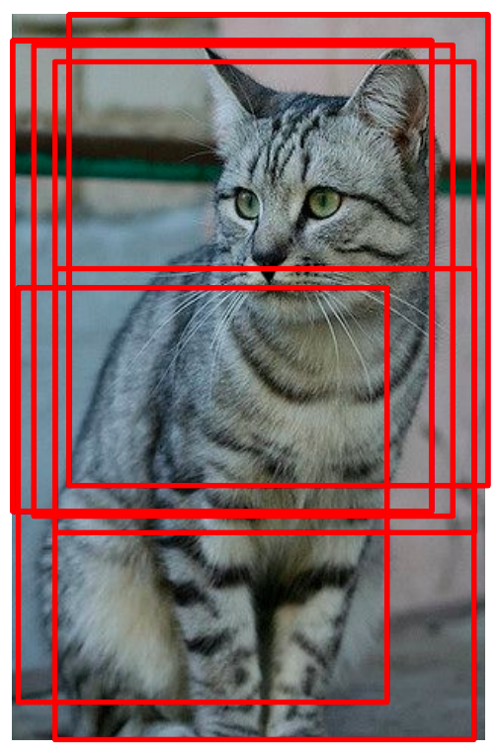
Data augmentation
Introduce transformations not adequately sampled in the training data
Geometric: flipping, rotation, shearing, multiple crops
Image source
Image source

Slide 33
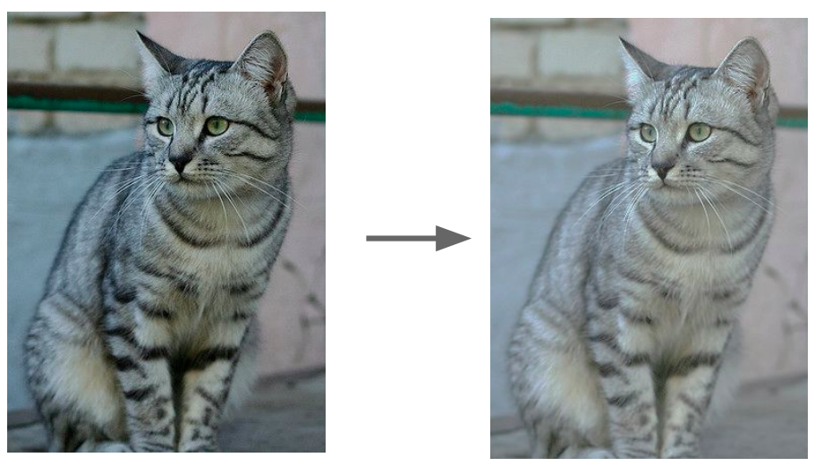
Data augmentation
Introduce transformations not adequately sampled in the training data
Geometric: flipping, rotation, shearing, multiple crops
Photometric: color transformations
Image source

Slide 34
Data augmentation
Introduce transformations not adequately sampled in the training data
Geometric: flipping, rotation, shearing, multiple crops
Photometric: color transformations
Other: add noise, compression artifacts, lens distortions, etc.
Image source

Slide 35
Data augmentation
Introduce transformations not adequately sampled in the training data
Limited only by your imagination and time/memory constraints!
Avoid introducing artifacts
Image source

Slide 36
Data augmentation
Introduce transformations not adequately sampled in the training data
Limited only by your imagination and time/memory constraints!
Avoid introducing artifacts
Automatic augmentation strategies: AutoAugment, RandAugment

Slide 37
Data preprocessing
Zero centering
Subtract mean image – all input images need to have the same resolution
Subtract per-channel means – images don’t need to have the same resolution
Optional: rescaling – divide each value by (per-pixel or per-channel) standard deviation
Be sure to apply the same transformation at training and test time!
Save training set statistics and apply to test data

Slide 38
Weight initialization
What’s wrong with initializing all weights to the same number (e.g., zero)?

Slide 39
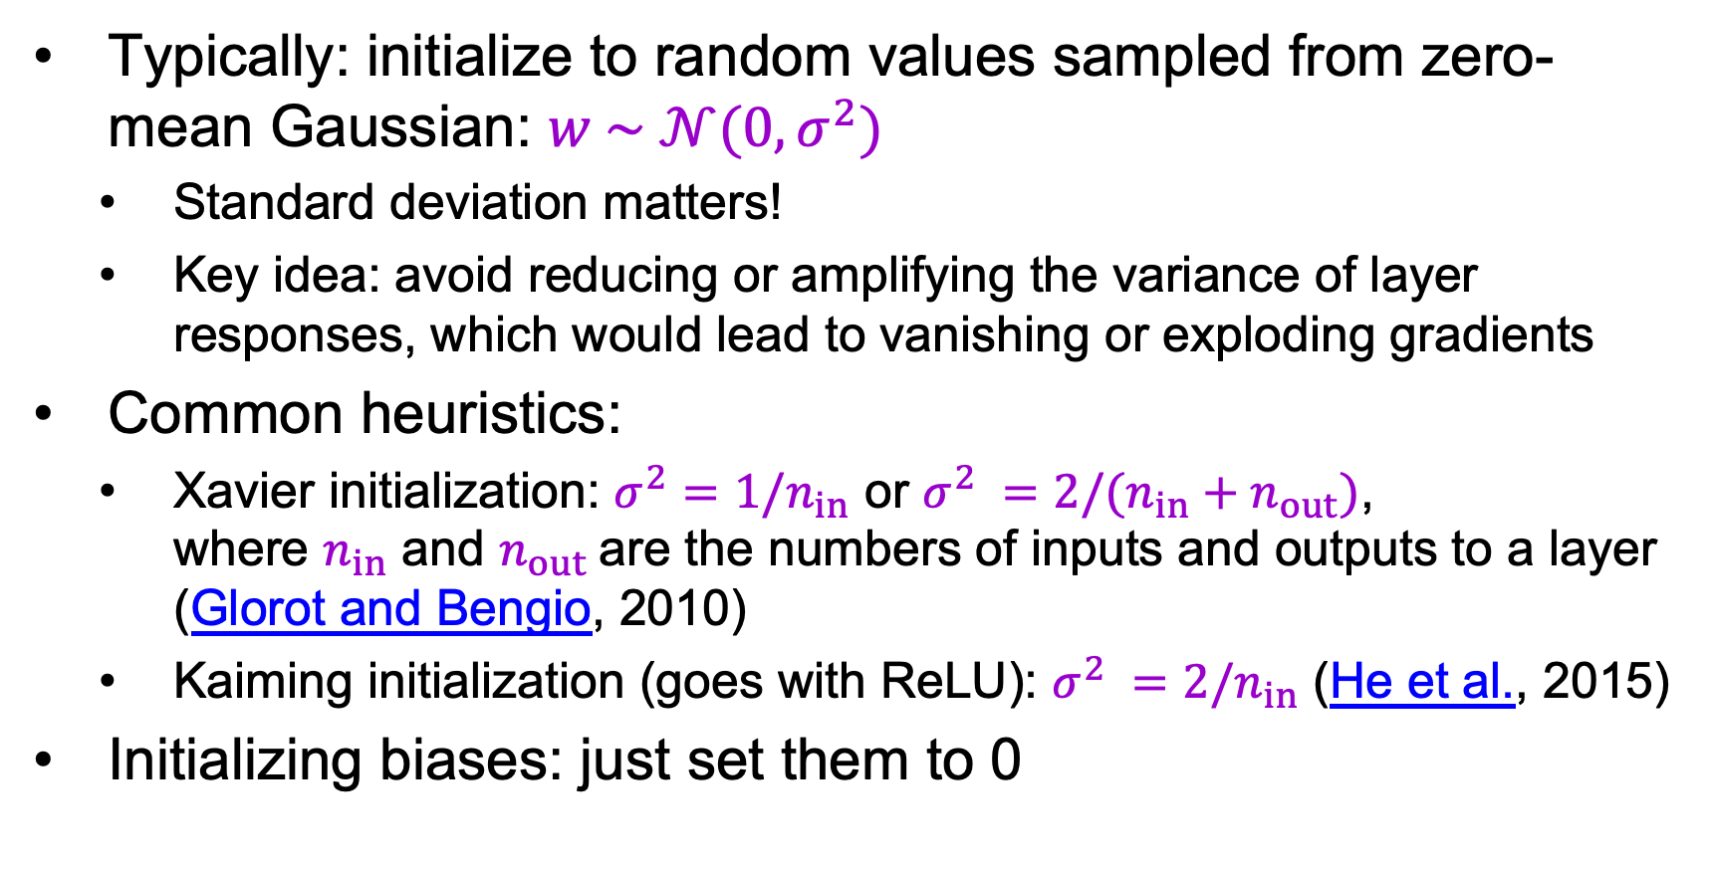
Weight initialization
Typically: initialize to random values sampled from zero-mean Gaussian: $w \sim 𝒩(0, σ^{2})$
Standard deviation matters!
Key idea: avoid reducing or amplifying the variance of layer responses, which would lead to vanishing or exploding gradients
Common heuristics:
Xavier initialization: $σ^{2}={1/n}_{in}$ or $σ^{2} ={2/(n}_{in}+n_{out})$, where $n_{in}$ and $n_{out}$are the numbers of inputs and outputs to a layer (Glorot and Bengio, 2010)
Kaiming initialization (goes with ReLU): $σ^{2} ={2/n}_{in}$ (He et al., 2015)
Initializing biases: just set them to 0
More details: http://cs231n.github.io/neural-networks-2/#init

Slide 40
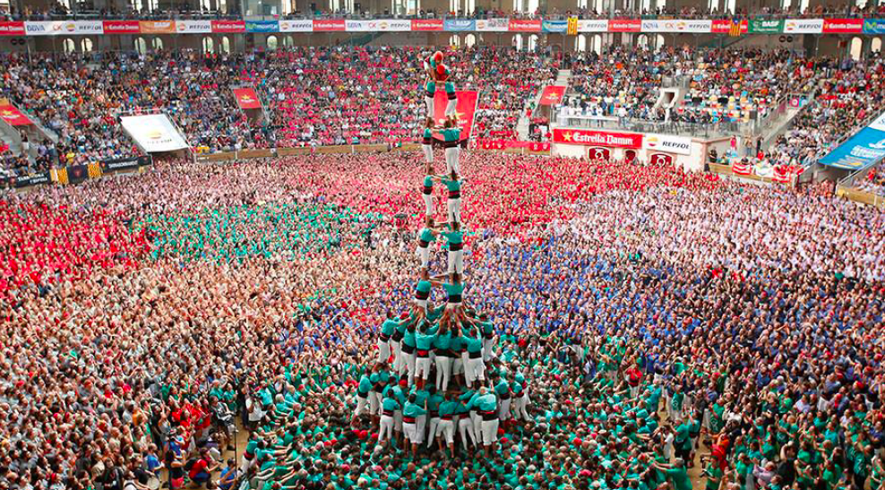
Batch normalization
The authors’ intuition
Image source, via Prajit Ramachandran
S. Ioffe, C. Szegedy, Batch Normalization: Accelerating Deep Network Training by Reducing Internal Covariate Shift, ICML 2015

Slide 41
Batch normalization
Key idea: shifting and rescaling are differentiable operations, so the network can learn how to best normalize the data
Statistics of activations (outputs) from a given layer across the dataset can be approximated by statistics from a mini-batch
S. Ioffe, C. Szegedy, Batch Normalization: Accelerating Deep Network Training by Reducing Internal Covariate Shift, ICML 2015

Slide 42
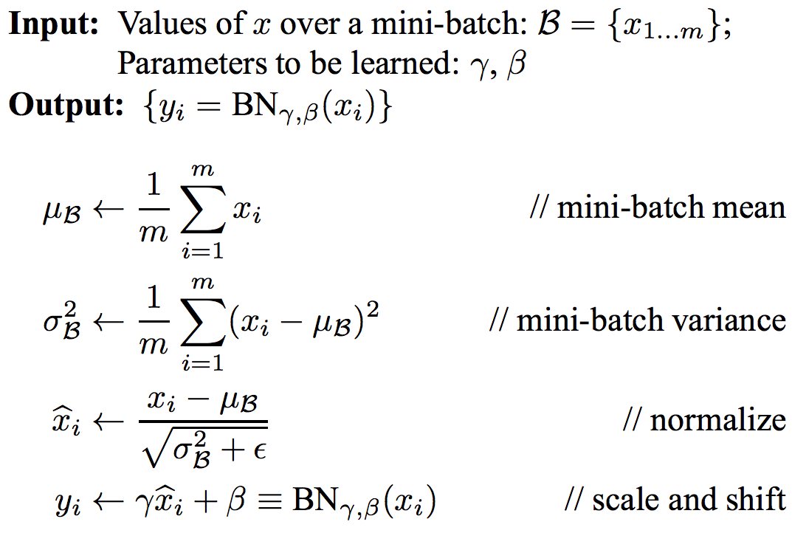
Batch normalization
Why?
S. Ioffe, C. Szegedy, Batch Normalization: Accelerating Deep Network Training by Reducing Internal Covariate Shift, ICML 2015
Notes:
From the paper: Note that simply normalizing each input of a layer may change what the layer can represent. For instance, normalizing the inputs of a sigmoid would constrain them to the linear regime of the nonlinearity. To address this, we make sure that the transformation inserted in the network can represent the identity transform. To accomplish this, we introduce, for each activation x (k) , a pair of parameters γ (k) , β(k) , which scale and shift the normalized value. Indeed, by setting γ (k) = p Var[x (k) ] and β (k) = E[x (k) ], we could recover the original activations, if that were the optimal thing to do.

Slide 43
Batch normalization
At test time (usually):
training set
training set
S. Ioffe, C. Szegedy, Batch Normalization: Accelerating Deep Network Training by Reducing Internal Covariate Shift, ICML 2015

Slide 44
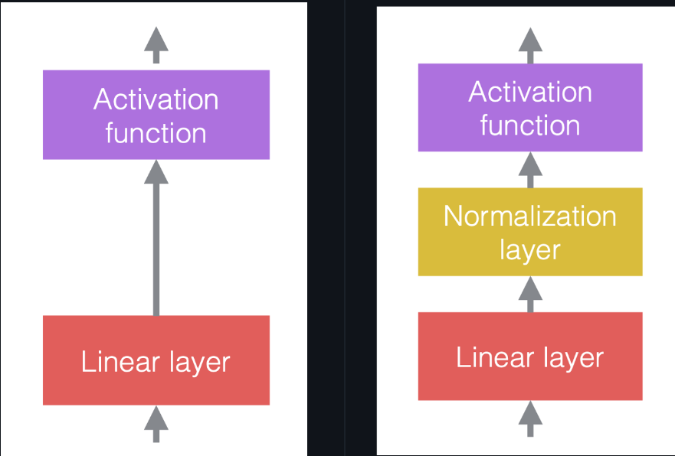
Batch normalization
Common configuration: insert BN layers right after conv or FC layers, before ReLU nonlinearity (but this is purely empirical)
conv
BN
BN
ReLU
conv
ReLU
S. Ioffe, C. Szegedy, Batch Normalization: Accelerating Deep Network Training by Reducing Internal Covariate Shift, ICML 2015
Notes:
Rather than improving the optimization algorithms, normalization layers improve the network structure itself. They are additional layers in between existing layers. The goal is to improve the optimization and generalization performance.
In neural networks, we typically alternate linear operations with non-linear operations. The non-linear operations are also known as activation functions, such as ReLU. We can place normalization layers before the linear layers, or after the activation functions. The most common practice is to put them between the linear layers and activation functions. Note that the normalization layers affect the data that flows through, but they don’t change the power of the network in the sense that, with proper configuration of the weights, the unnormalized network can still give the same output as a normalized network.

Slide 45
Batch normalization
Benefits
Prevents exploding and vanishing gradients
Keeps most activations away from saturation regions of non-linearities
Accelerates convergence of training
Makes training more robust w.r.t. hyperparameter choice, initialization
Pitfalls
Behavior depends on composition of mini-batches, can lead to hard-to-catch bugs if there is a mismatch between training and test regime (example)
Doesn’t work well for small mini-batch sizes
Cannot be used for certain types of models (recurrent models, transformers)

Slide 46
Why does BatchNorm really work?
It may have to do not with internal covariate shift (ICS), but with making the optimization problem much smoother (Santurkar et al., 2018)
Is ICS even a thing? (Lipton and Steinhardt, 2018)

Slide 47
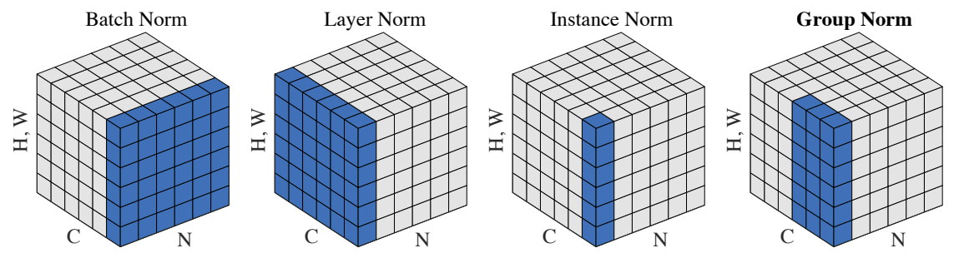
Other types of normalization
Layer normalization (Ba et al., 2016)
Instance normalization (Ulyanov et al., 2017)
Group normalization (Wu and He, 2018)
Weight normalization (Salimans et al., 2016)
Y. Wu and K. He, Group Normalization, ECCV 2018
Notes:
his is the generic notation for normalization:
y = \frac{a}{\sigma}(x - \mu) + by=σa​(x−μ)+bwhere xx is the input vector, yy is the output vector, \muμ is the estimate of the mean of xx, \sigmaσ is the estimate of the standard deviation (std) of xx, aa is the learnable scaling factor, and bb is the learnable bias term.
Without the learnable parameters aa and bb, the distribution of output vector yy will have fixed mean 0 and std 1. The scaling factor aa and bias term bb maintain the representation power of the network,i.e.the output values can still be over any particular range. Note that aa and bb do not reverse the normalization, because they are learnable parameters and are much more stable than \muμ and \sigmaσ.
Figure 4: Normalization operations.There are several ways to normalize the input vector, based on how to select samples for normalization. Figure 4 lists 4 different normalization approaches, for a mini-batch of NN images of height HH and width WW, with CC channels:
Batch norm: the normalization is applied only over one channel of the input. This is the first proposed and the most well-known approach. Please read How to Train Your ResNet 7: Batch Norm for more information.
Layer norm: the normalization is applied within one image across all channels.
Instance norm: the normalization is applied only over one image and one channel.
Group norm: the normalization is applied over one image but across a number of channels. For example, channel 0 to 9 is a group, then channel 10 to 19 is another group, and so on. In practice, the group size is almost always 32. This is the approach recommended by Aaron Defazio, since it has good performance in practice and it does not conflict with SGD.
In practice, batch norm and group norm work well for computer vision problems, while layer norm and instance norm are heavily used for language problems.

Slide 48
Outline
Optimization
Mini-batch SGD
Learning rate decay
Adaptive methods
Massaging the numbers
Data augmentation
Data preprocessing
Weight initialization
Batch normalization
Regularization

Slide 49
Regularization
Techniques for controlling the capacity of a neural network to prevent overfitting – short of explicit reduction of the number of parameters
Recall: classic regularization: L1, L2
Image source

Slide 50
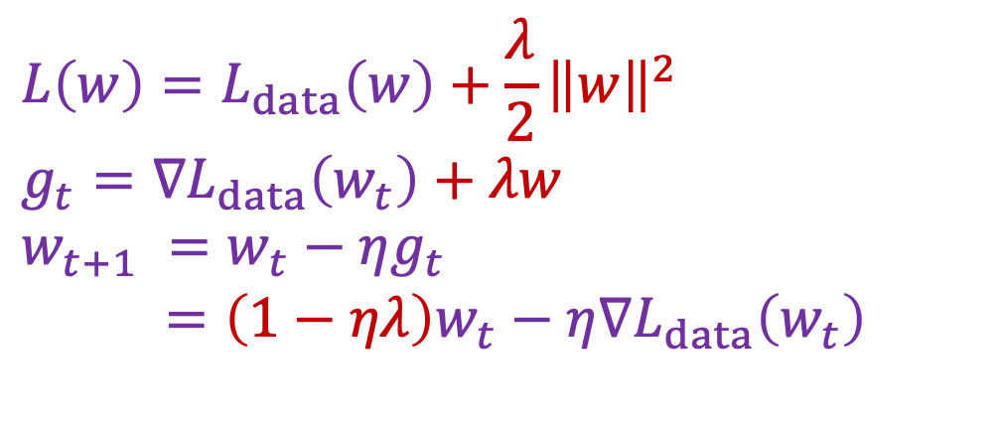
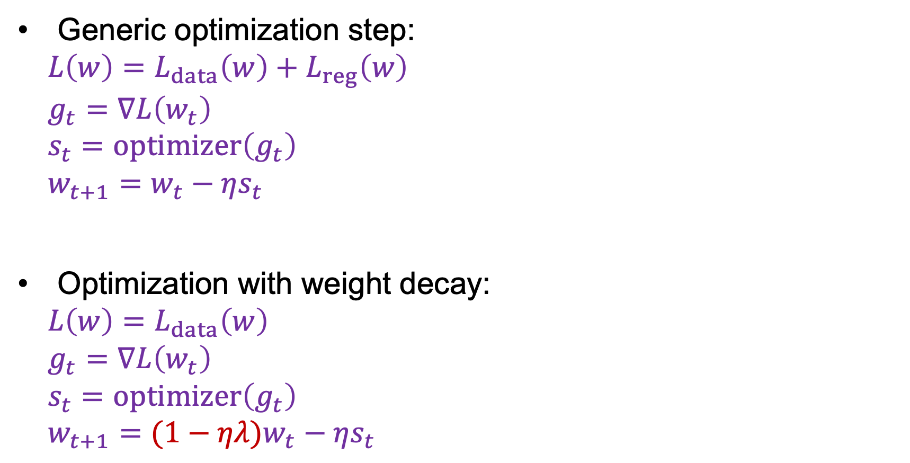
Weight decay
Generic optimization step:
$$L\left(w\right)=L_{data}\left(w\right)+L_{reg}\left(w\right)$$
$$g_{t}=∇L\left(w_{t}\right)$$
$$s_{t}=optimizer\left(g_{t}\right)$$
$$w_{t+1}=w_{t}−ηs_{t}$$
Optimization with weight decay:
$$L\left(w\right)=L_{data}\left(w\right)$$
$$g_{t}=∇L\left(w_{t}\right)$$
$$s_{t}=optimizer\left(g_{t}\right)$$
$$w_{t+1}=(1−ηλ)w_{t}−ηs_{t}$$
SGD with L2 regularization:
$$L\left(w\right)=L_{data}\left(w\right)+\frac{λ}{2}{\left\|w\right\|}^{2}$$
$$g_{t}=∇L_{data}\left(w_{t}\right)+λw$$
$$w_{t+1} =w_{t}−ηg_{t}$$
$=\left(1−ηλ\right)w_{t}−η∇L_{data}\left(w_{t}\right)$
I. Loshchilov and F. Hutter, Decoupled Weight Decay Regularization, ICLR 2019
Adapted from J. Johnson

Slide 51
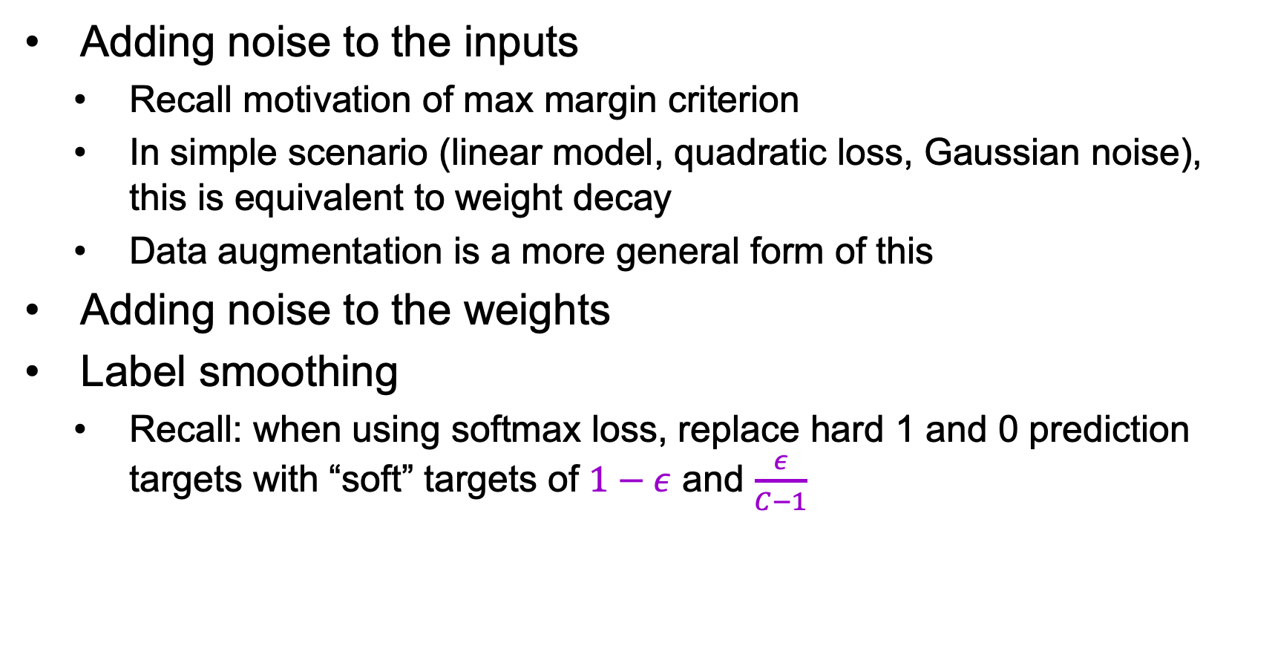
Other types of regularization
Adding noise to the inputs
Recall motivation of max margin criterion
In simple scenario (linear model, quadratic loss, Gaussian noise), this is equivalent to weight decay
Data augmentation is a more general form of this
Adding noise to the weights
Label smoothing
Recall: when using softmax loss, replace hard 1 and 0 prediction targets with “soft” targets of $1−ε$ and $\frac{ε}{C−1}$

Slide 52
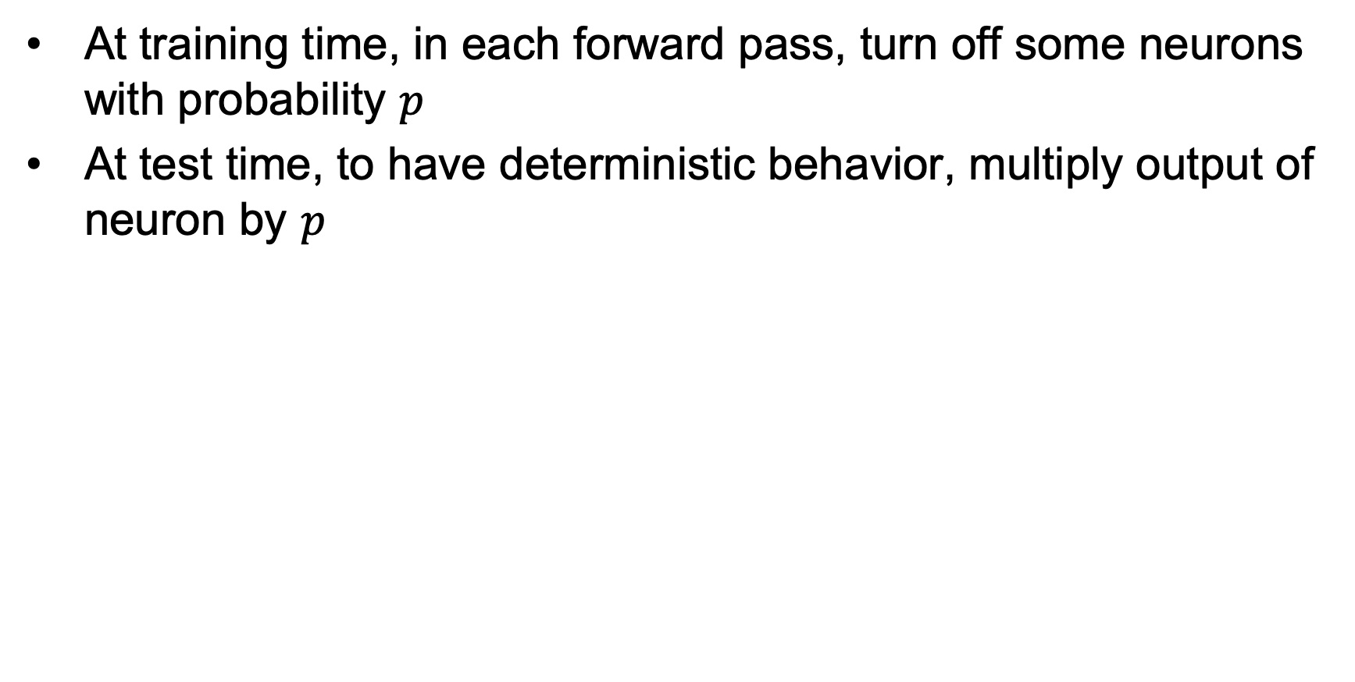
Dropout
At training time, in each forward pass, turn off some neurons with probability $p$
At test time, to have deterministic behavior, multiply output of neuron by $p$
N. Srivastava, G. Hinton, A. Krizhevsky, I. Sutskever, R. Salakhutdinov. Dropout: A Simple Way to Prevent Neural Networks from Overfitting. JMLR 2014

Slide 53
Dropout
Intuitions
Prevent “co-adaptation” of units, increase robustness to noise
Train implicit ensemble
N. Srivastava, G. Hinton, A. Krizhevsky, I. Sutskever, R. Salakhutdinov. Dropout: A Simple Way to Prevent Neural Networks from Overfitting. JMLR 2014

Slide 54
Current status of dropout
Against
Slows down convergence
Made redundant by batch normalization or possibly even clashes with it
Unnecessary for larger datasets or with sufficient data augmentation
In favor
Can still help for certain models and in certain situations: e.g., used in Wide Residual Networks

Slide 55
Outline
Optimization
Mini-batch SGD
Learning rate decay
Adaptive methods
Massaging the numbers
Data augmentation
Data preprocessing
Weight initialization
Batch normalization
Regularization
Test time: ensembles, averaging predictions

Slide 56
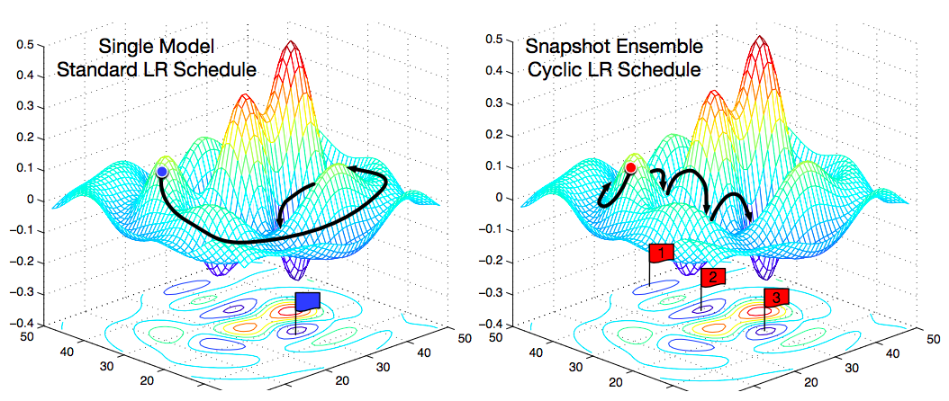
Test time
Ensembles: train multiple independent models, then average their predicted label distributions
Gives 1-2% improvement in most cases
Can take multiple snapshots of models obtained during training, especially if you cycle the learning rate (increase to jump out of local minima)
G. Huang et al., Snapshot ensembles: Train 1, get M for free, ICLR 2017

Slide 57
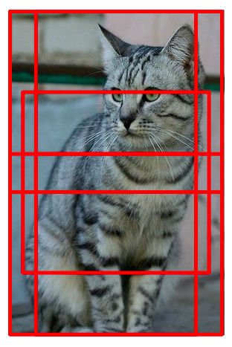
Test time
Average predictions across multiple crops of test image
There is a more elegant way to do this with fully convolutional networks (FCNs)

Slide 58
Outline
Optimization
Mini-batch SGD
Learning rate decay
Adaptive methods
Massaging the numbers
Data augmentation
Data preprocessing
Weight initialization
Batch normalization
Regularization
Test time: ensembles, averaging predictions
Transfer learning, distillation

Slide 59
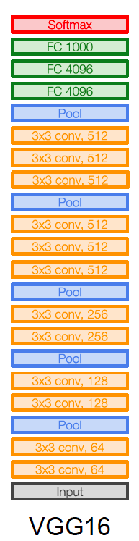
Transfer learning
Train new prediction layer(s)
Keep frozen or fine-tune

Slide 60
Distillation
Train a teacher network on initial labeled dataset
Save the softmax outputs the teacher network for each training example
Train a student network with cross-entropy loss using the softmax outputs of the teacher network as targets
Many uses
Compressing a larger model (or even an ensemble) into a smaller one
“Copying” a black-box teacher model (e.g., network you can only access via an API)
Extending a network to additional tasks without “forgetting” old tasks (Li and Hoiem, 2017)
G. Hinton, O. Vinyals, J. Dean. Distilling the knowledge in a neural network. arXiv 2015

Slide 61
Some take-aways
Training neural networks is still a black art
Process requires close “babysitting”
For many techniques, the reasons why, when, and whether they work are in active dispute – read everything but don’t trust anything
It all comes down to (principled) trial and error
Further reading: A. Karpathy, A recipe for training neural networks

